Slide 1
ELECTROSTATICS
CH 21 &22
CLO:5 OBTAIN UNDERSTANDING OF BASIC CONCEPTS OF ELECTROMAGNETISM.(ADDITIONAL CLO)

Slide 2
MAJOR APPLICATIONS OF ELECTROSTATICS
CAPACITIVE TOUCHSCREENS – WORK ON THE PRINCIPLE OF ELECTROSTATIC CHARGE DETECTION (USED IN MOBILES AND TABLETS).
LASER PRINTERS & PHOTOCOPIERS – USE ELECTROSTATIC FORCES TO ATTRACT TONER POWDER ONTO PAPER FOR PRINTING OR COPYING.
ELECTROSTATIC PRECIPITATORS – REMOVE DUST AND SMOKE PARTICLES FROM EXHAUST GASES IN INDUSTRIES AND POWER PLANTS.
ELECTROSTATIC PAINTING/SPRAYING – PAINT PARTICLES ARE CHARGED TO ENSURE UNIFORM COATING AND REDUCE WASTAGE.
ELECTROSTATIC DISCHARGE (ESD) PROTECTION – PREVENTS DAMAGE TO ELECTRONIC CIRCUITS AND COMPUTER COMPONENTS.

Slide 3
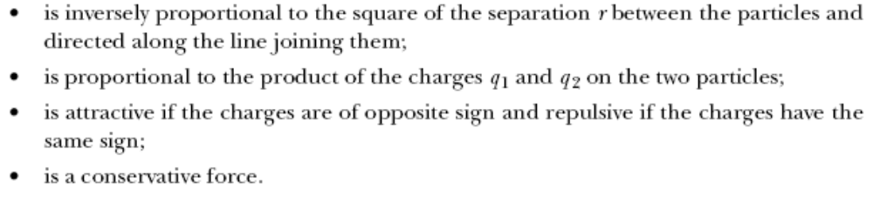
COULOMB’S EXPERIMENT RESULTS
The electric force between two stationary charged particles
The term point charge refers to a particle of zero size that carries an electric charge
  The electrical behavior of electrons and protons is well described by modeling them as point charges

Slide 4
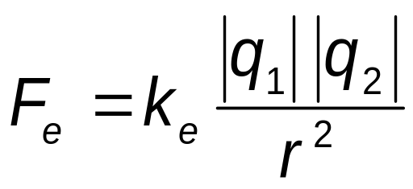
COULOMB’S LAW, EQUATION
MATHEMATICALLY,
THE SI UNIT OF CHARGE IS THE COULOMB (C)
K_{E} IS CALLED THE COULOMB CONSTANT
  K_{E} = 1/(4ΠΕ_{O})= 8.9876 X 10⁹ N.M²/C²
  Ε_{O} IS THE PERMITTIVITY OF FREE SPACE
  Ε_{O} = 8.8542 X 10⁻¹² C² / N.M²

Slide 5

PROBLEM SOLVING 1

Slide 6
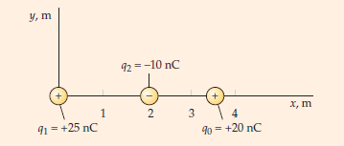
PROBLEM SOLVING 1 CONTIN…

Slide 7
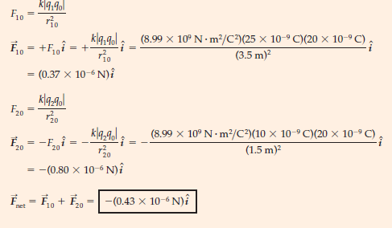

Slide 8
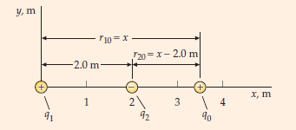
PROBLEM SOLVING CONTIN….

Slide 9
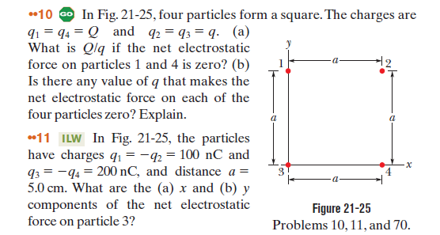
H/R/W CH 21

Slide 10
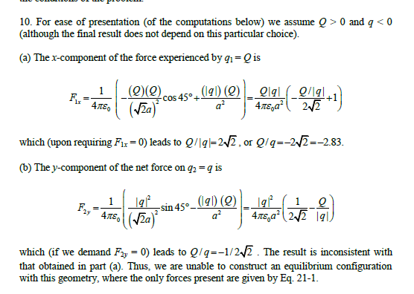

Slide 11
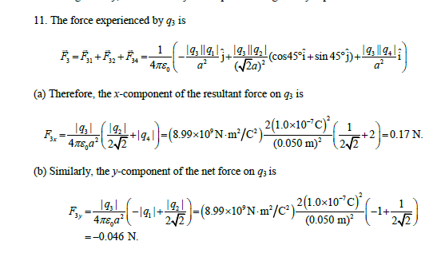

Slide 12
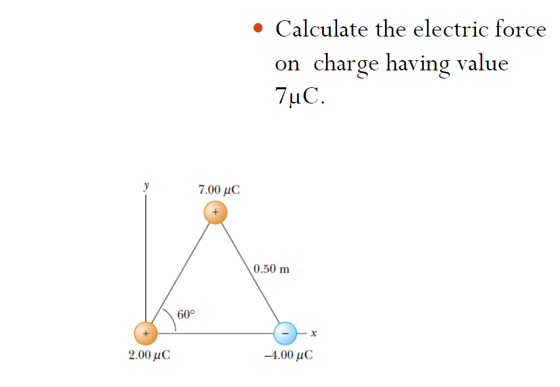

Slide 13
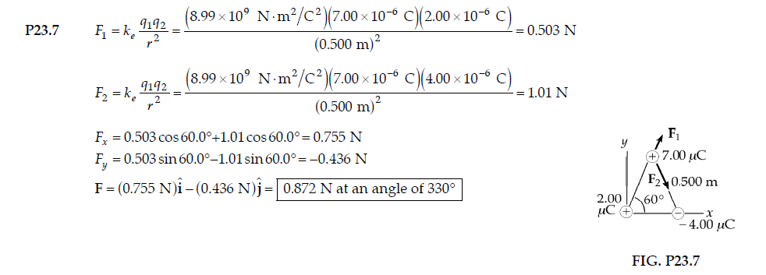

SOLUTION

Slide 14
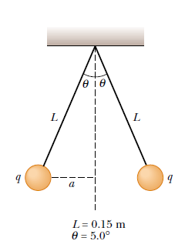
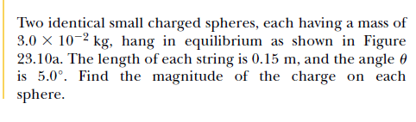

Slide 15
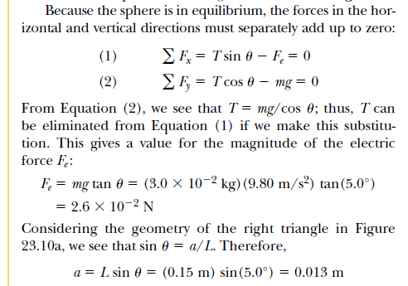
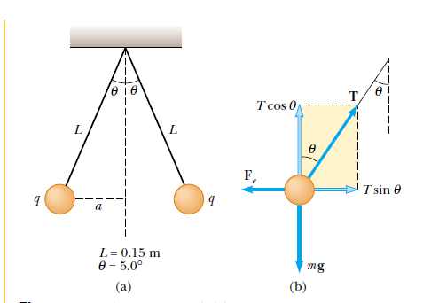

Slide 16
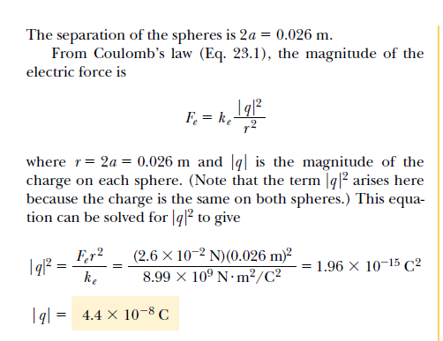

Slide 17
THE ELECTRIC FIELD
THE ELECTRIC FORCE IS A FIELD FORCE.
FIELD FORCES CAN ACT THROUGH SPACE.
THE EFFECT IS PRODUCED EVEN WITH NO PHYSICAL CONTACT BETWEEN OBJECTS.
AN ELECTRIC FIELD IS SAID TO EXIST IN THE REGION OF SPACE AROUND A CHARGED OBJECT
  THIS CHARGED OBJECT IS THE SOURCE CHARGE.
WHEN ANOTHER CHARGED OBJECT, THE TEST CHARGE, ENTERS THIS ELECTRIC FIELD, AN ELECTRIC FORCE ACTS ON IT

Slide 18
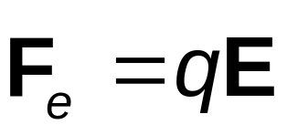
RELATIONSHIP BETWEEN F AND E
  THIS IS VALID FOR A POINT CHARGE ONLY
  FOR LARGER OBJECTS, THE FIELD MAY VARY OVER THE SIZE OF THE OBJECT
IF Q IS POSITIVE, THE FORCE AND THE FIELD ARE IN THE SAME DIRECTION
IF Q IS NEGATIVE, THE FORCE AND THE FIELD ARE IN OPPOSITE DIRECTIONS

Slide 19
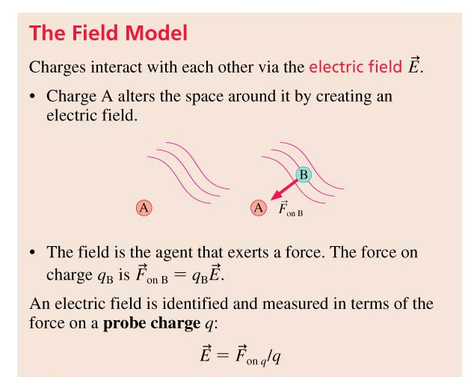
IMPORTANT CONCEPTS
Slide 25-110

Slide 20
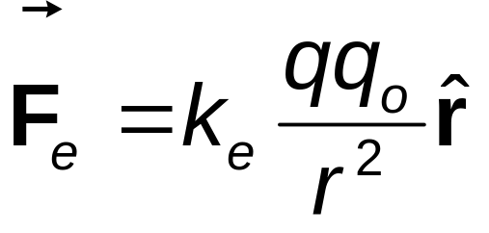
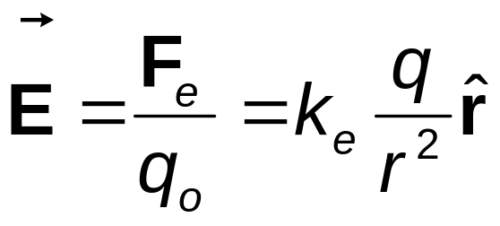
ELECTRIC FIELD, VECTOR FORM
REMEMBER COULOMB’S LAW, BETWEEN THE SOURCE AND TEST CHARGES, CAN BE EXPRESSED AS
THEN, THE ELECTRIC FIELD WILL BE

Slide 21
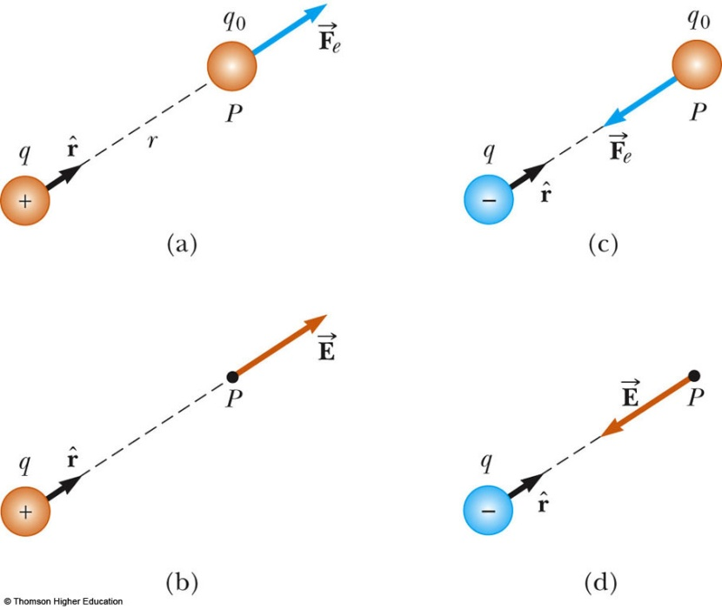
MORE ABOUT ELECTRIC FIELD DIRECTION
A) Q IS POSITIVE, THE FORCE IS DIRECTED AWAY FROM Q
B) THE DIRECTION OF THE FIELD IS ALSO AWAY FROM THE POSITIVE SOURCE CHARGE
C) Q IS NEGATIVE, THE FORCE IS DIRECTED TOWARD Q
D) THE FIELD IS ALSO TOWARD THE NEGATIVE SOURCE CHARGE
PLAY
ACTIVE FIGURE

Slide 22
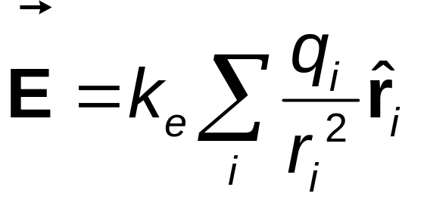
SUPERPOSITION WITH ELECTRIC FIELDS
AT ANY POINT P, THE TOTAL ELECTRIC FIELD DUE TO A GROUP OF SOURCE CHARGES EQUALS THE VECTOR SUM OF THE ELECTRIC FIELDS OF ALL THE CHARGES

Slide 23
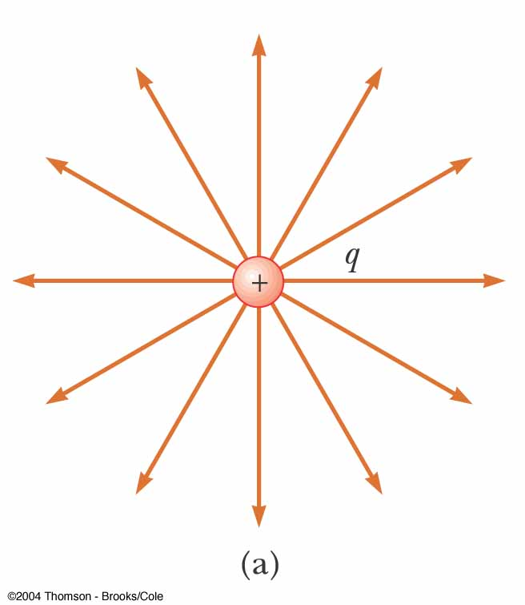
ELECTRIC FIELD LINES, POSITIVE POINT CHARGE
THE FIELD LINES RADIATE OUTWARD IN ALL DIRECTIONS
  IN THREE DIMENSIONS, THE DISTRIBUTION IS SPHERICAL
THE LINES ARE DIRECTED AWAY FROM THE SOURCE CHARGE
  A POSITIVE TEST CHARGE WOULD BE REPELLED AWAY FROM THE POSITIVE SOURCE CHARGE

Slide 24
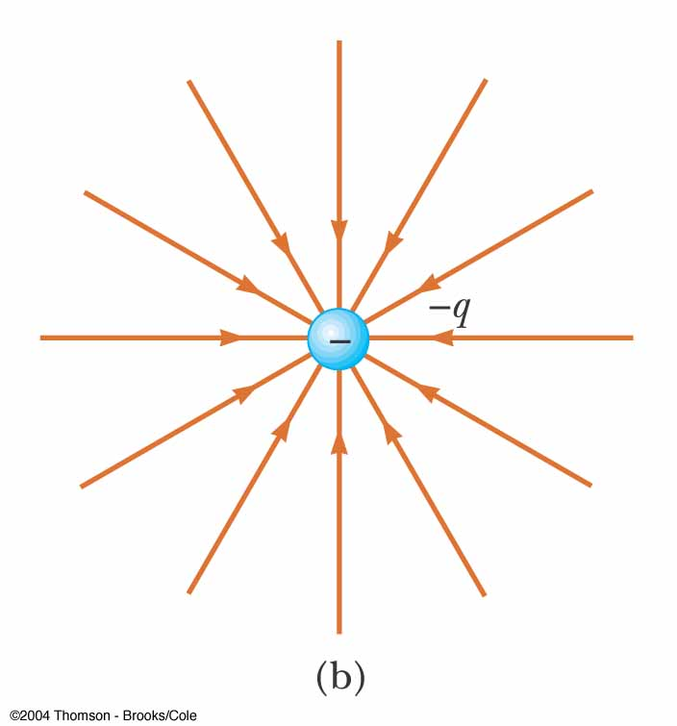
ELECTRIC FIELD LINES, NEGATIVE POINT CHARGE
THE FIELD LINES RADIATE INWARD IN ALL DIRECTIONS
THE LINES ARE DIRECTED TOWARD THE SOURCE CHARGE
  A POSITIVE TEST CHARGE WOULD BE ATTRACTED TOWARD THE NEGATIVE SOURCE CHARGE

Slide 25
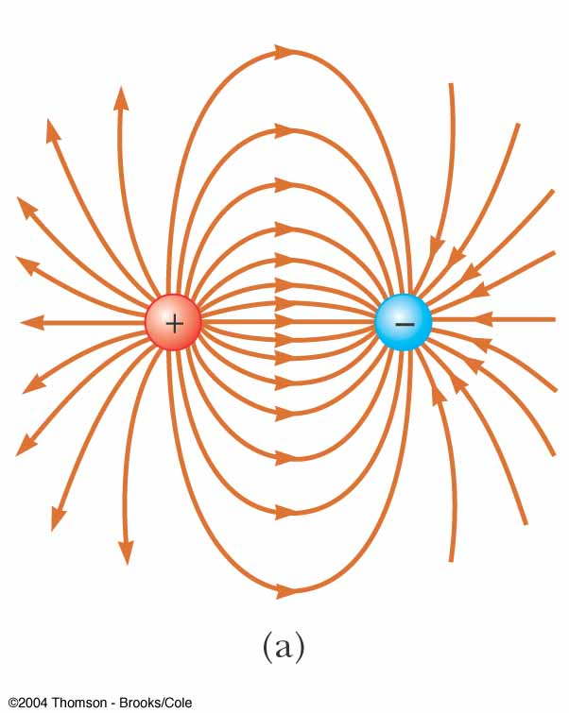
ELECTRIC FIELD LINES – DIPOLE
THE CHARGES ARE EQUAL AND OPPOSITE
THE NUMBER OF FIELD LINES LEAVING THE POSITIVE CHARGE EQUALS THE NUMBER OF LINES TERMINATING ON THE NEGATIVE CHARGE

Slide 26
Chapter 22 Electric Fields
Key contents
Electric field for a dipole
The electric field due to N-NUMBER OF CHARGES

Slide 27
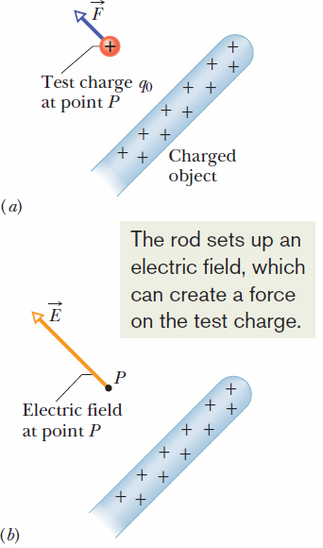

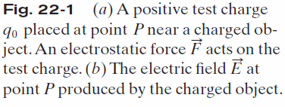
22.2 The Electric Field:
The electric field is a vector field.
The SI unit for the electric field is the newton per coulomb (N/C).

Slide 28
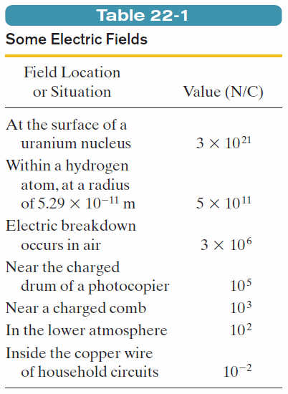
22.2 The Electric Field:

Slide 29
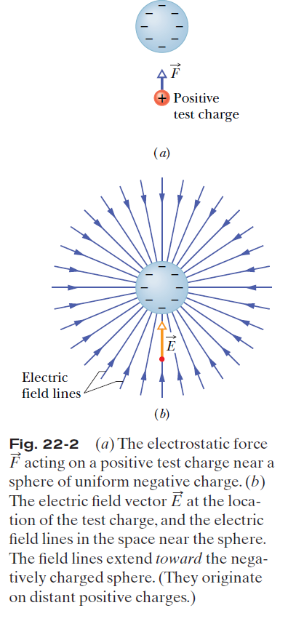
22.3 Electric Field Lines:
Electric field lines are imaginary lines which extend away from positive charge (where they originate) and toward negative charge (where they terminate).
At any point, the direction of the tangent to a curved field line gives the direction of the electric field at that point.
The field lines are drawn so that the number of lines per unit area, measured in a plane that is perpendicular to the lines, is proportional to the magnitude of E. Thus, E is large where field lines are close together and small where they are far apart.

Slide 30
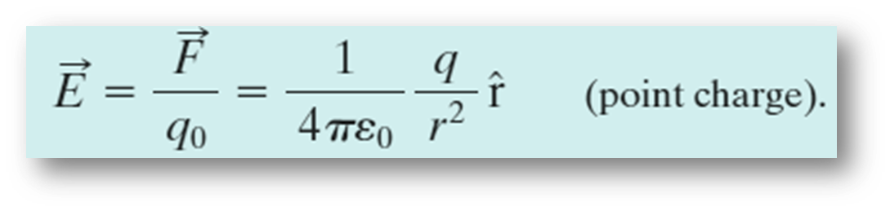

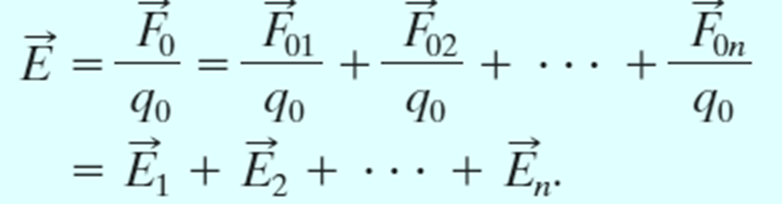
22.4 The Electric Field due to a Point:

Slide 31


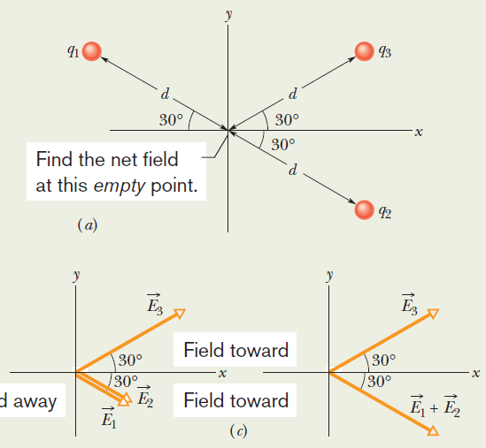
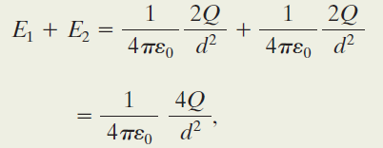
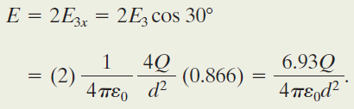
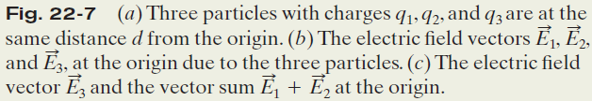
Example, The net electric field due to three charges:
From the symmetry of Fig. 22-7c, we realize that the equal y components of our two vectors cancel and the equal x components add.
Thus, the net electric field at the origin
is in the positive direction of the x axis and has the magnitude

Slide 32
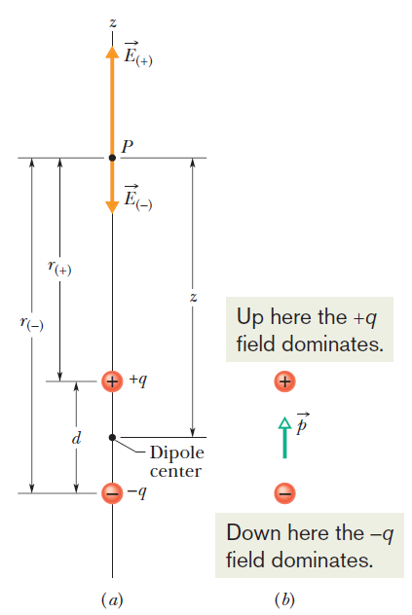
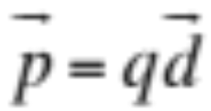
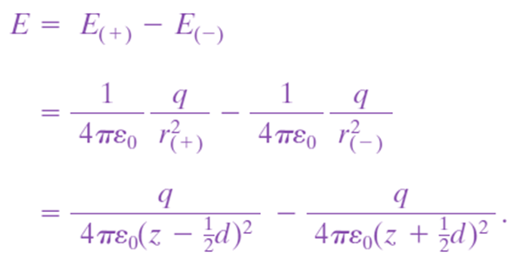
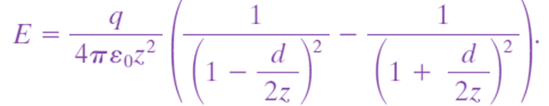
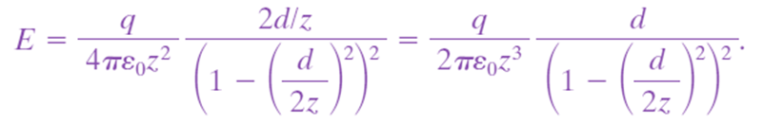


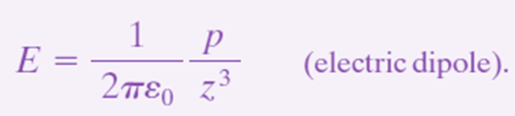
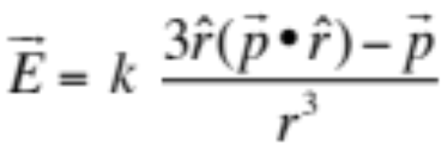
22.5 The Electric Field due to an Electric Dipole:
, a vector quantity known as the electric dipole moment of the dipole
A general form for the electric dipole field is

Slide 33
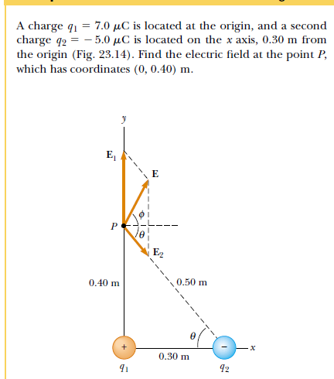
PROBLEM SOLVING 1

Slide 34
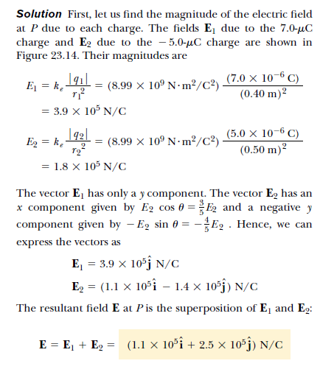

Slide 35
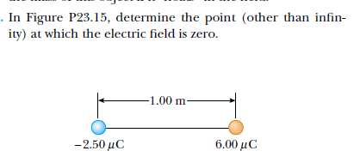
PROBLEM SOLVING 2

Slide 36
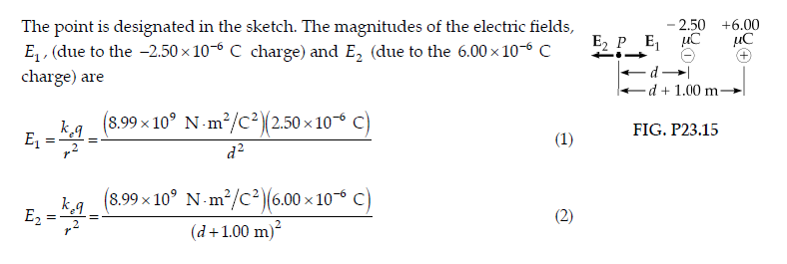
SOLUTION

Slide 37
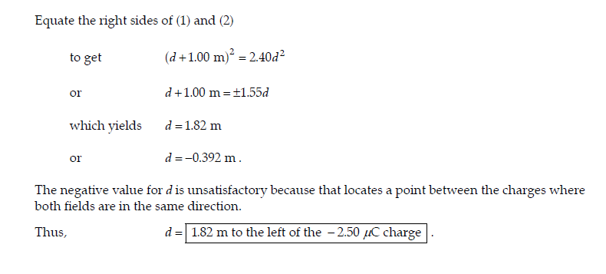
SOLUTION

Slide 38

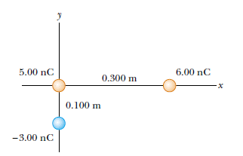
PROBLEM SOLVING 3

Slide 39
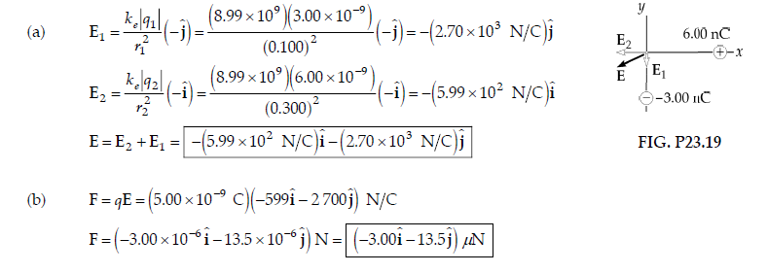
SOLUTION

